Slide 1
THE FUTURE OF TECHNOLOGY
AUTOMATED | SMART | SOLUTIONS
WWW.KONNECTEDTECHNOLOGY.COM

Slide 2
What We Do Best
Konnected Technology specializes in creating customized hardware and software solutions for high volume manufacturers. Our solutions are designed to connect any process within a manufacturing facility providing a compete production and asset overview while maintaining minimal impact to each individual process.

Slide 3
The Konnected Smart Factory
Modularized System than can manage every aspect of Manufacturing
Production Management
Sequencing System
Production Scheduling
Internal Conveyance
Part Quality Tracking
Critical issue tracking linked to Root Cause Analysis
Downtime Tracking
Instant Issue Notification System
Guided assembly
Production Broadcasts
Fully integrated to Production Management System to set production schedules based on Broadcast and WIP levels
Serialized Traceability throughout entire process
Automated Root Cause Analysis Notifications with adjustable trigger criteria
Accepts sequenced and non sequenced production orders
Can automatically schedule parts and subassemblies based on orders, ship dates and quality attrition
Full scheduling and tracking of part conveyance from production cells to the shipping bay door.
Automated backtrack collection and reporting
Can be used to track material movement from receipt of raw material through shipping of completed parts.
Many More Modules available and under development

Slide 4
Technologies We Develop
Many More Modules available and under development
If you need something different, we can do it!
LiDAR Conveyor Volume Tracking, LiDAR 3D Volume Tracking
Konnected HMI for guided assembly manufacturing at operators fingertips
PLC Integration – we have lots of experience integrating with existing PLCs to get your machinery communicating to you and to each other.
Sequenced Manufacturing system – we automatically schedule production to make sure that you meet your orders on time and minimize the need for buffer stocks
Asset Management – We can provide full asset overview from raw material to finished goods, including serialized part history using both RFID and non-RFID tracking methods.
Quality Control – With PLC or HMI integration we can track a shifts progress to trigger notification based on repeated quality issues, as well as providing root cause analysis to direct your resources to the source of the issue.
Production Dashboards – All of our systems will provide you a dashboard showing you all production data available so you can see the health of production each shift.

Slide 5
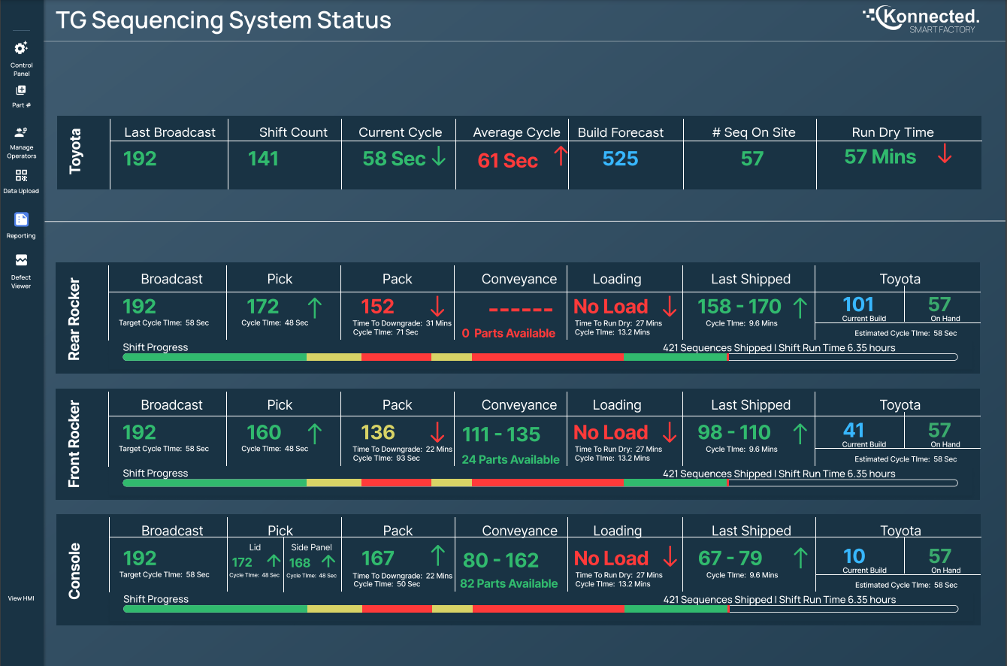
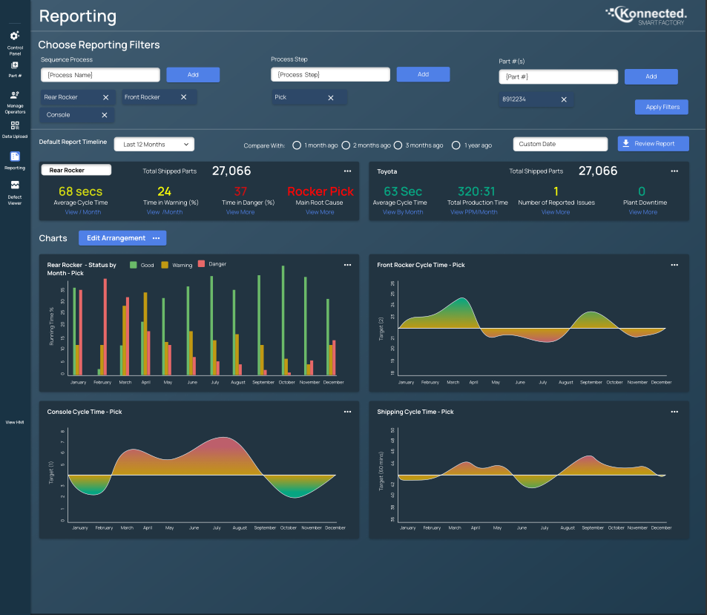
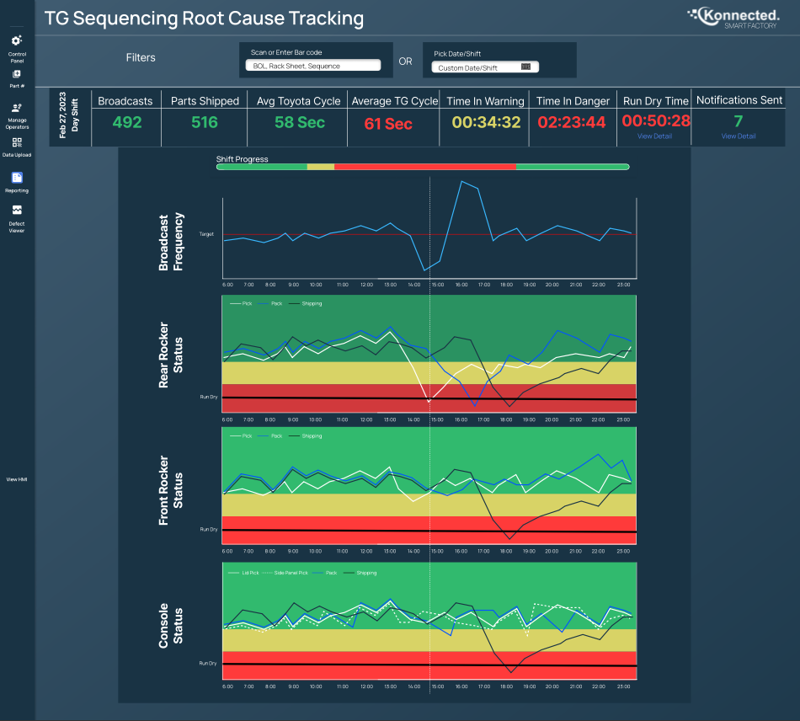
Examples of Our UI
Dashboard Overview
Shift Reports
Root Cause Tracking

Slide 6
With a long history in manufacturing engineering and management we know the struggles of finding SAS solutions that work not only for an individual process but also provide useful information about your entire facility; too many times solutions seem to only solve 70% of the issue wasting time, money, and often going unused.
That is why Konnected Technology’s mission is to create affordable solutions that are customized to your machines in your facility to connect your facility to Industry 4.0
Why Choose Us?
We love solving problems and providing our customers solutions that actually work for their process.

